Slide 1
Local Electricity Project: DIY Wind Turbine
SAFETY NOTE: Wind turbines can be extremely dangerous and should never be installed near highly populated areas. Always double check your work and make sure all fasteners use locking nuts or threadlocker.

Slide 2
Introduction
This is a guide to making your own low cost wind turbine using readily available parts, tools and labour. Please read the instructions all the way through before attempting to make your own turbine.
Most of the materials used were sourced from my local hardware store (Bunnings, Australia), with the exception of the treadmill motor, which was bought off eBay for $40AUD.
I tested the motor by turning it in a drill press and measured the voltage output at different speeds with a dummy load and datalogger, achieving 20W at 400RPM.
This wind turbine was built and tested with a maximum output of 20W, although more detailed analysis is required to determine the power curve.
Tools and materials required are listed below, but it should be noted that the instructions can be altered to suit your own circumstances.
We have split tools into those that are required, and those that are recommended for better precision, which is particularly important with the blades.

Slide 3
Contact Us
Our aim is to create a set of instructions that anyone can follow and in order to do this we need feedback.
Built this turbine? Send us a picture.
Have any suggestions to improve the design or the instructions? We’d love to hear from you.
You can contact us at:
http://localelectricity.org/contact/

Slide 4
Next Steps
This is a first attempt at creating a wind turbine that fits our requirements and a set of instructions to go with it. While we are reasonably happy with the success we acknowledge that there is plenty of room for improvement!
Tower/foundation – we have not yet addressed how to mount the tower, we will be creating some guidelines on this soon.
Furling – a good wind turbine should have a system to stop it spinning too fast in high winds. We will be incorporating a passive furling system into the next instructions.
Power curve – while we have done some basic testing in the wind, we will be logging the power output at various wind speeds using an anemometer to develop a detailed power curve which will allow us to incorporate improvements and test their effect.
More power – ideally we want to achieve 50W in moderate wind conditions. This will require a new motor and we are on the lookout!
PVC – we appreciate that PVC is not ideal for applications in direct sunlight. This can be rectified by painting with paint that protects from UV rays, but we are looking to minimise use of PVC with our next design.

Slide 5
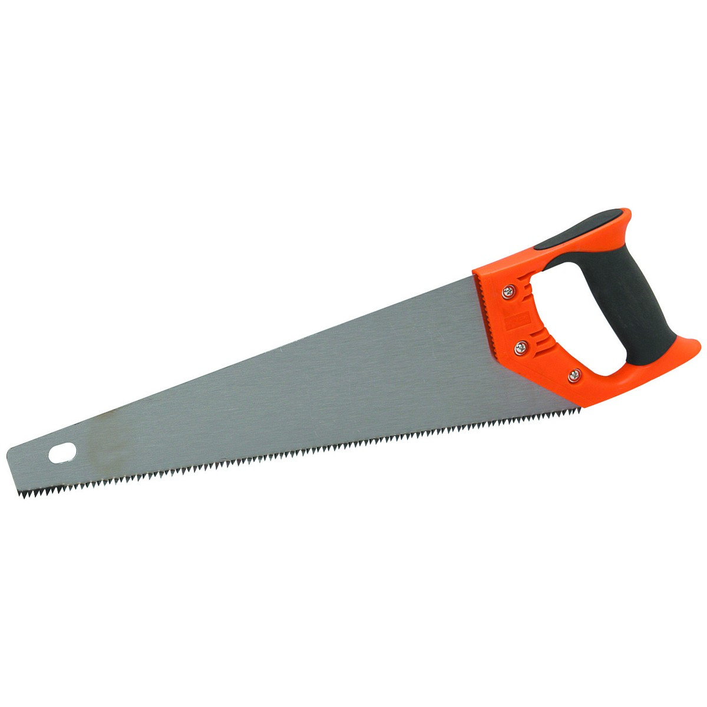
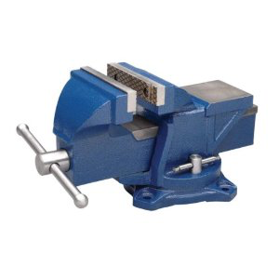
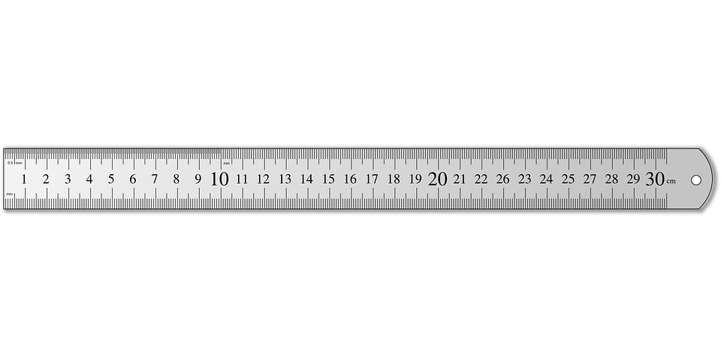
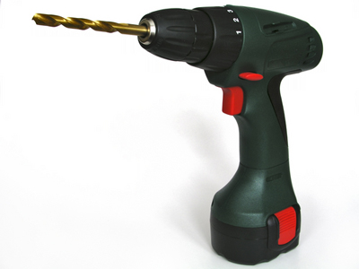
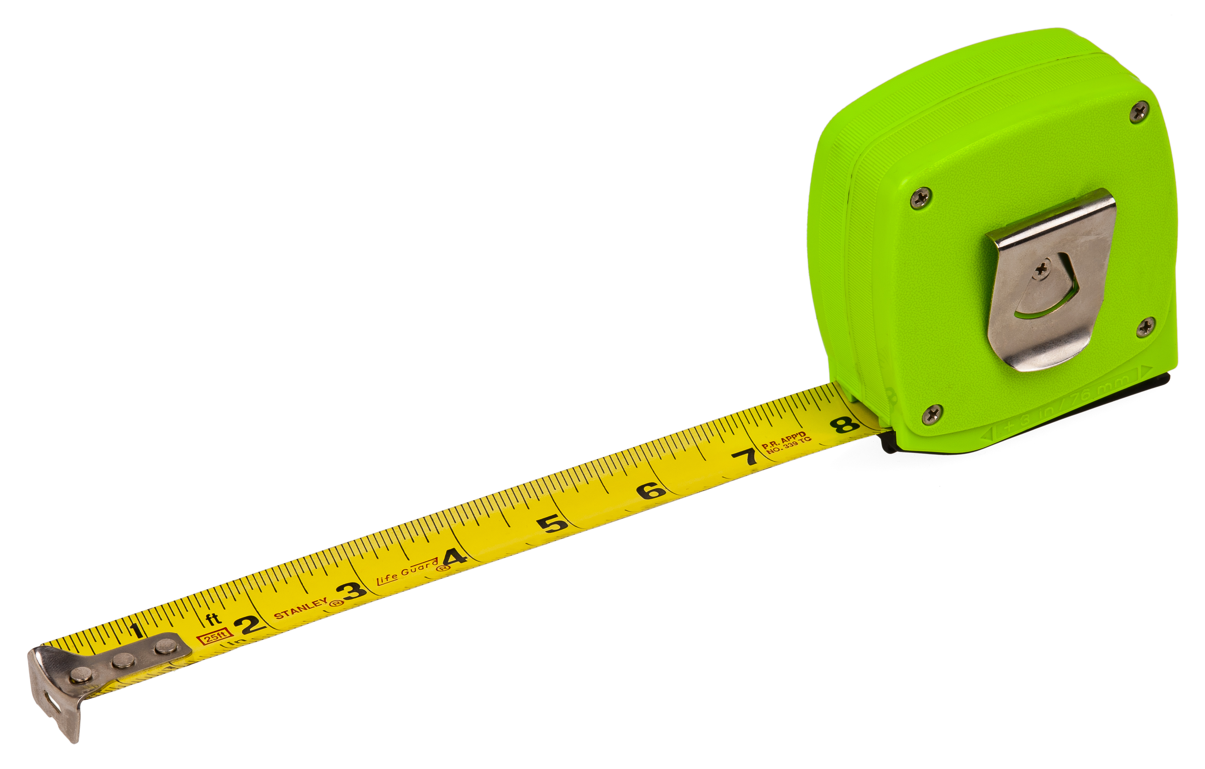
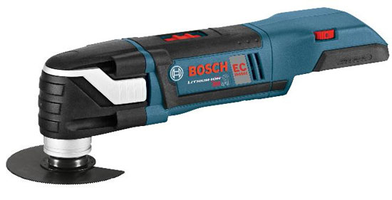
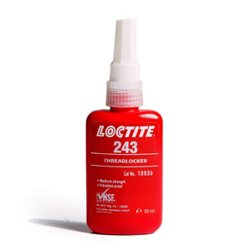
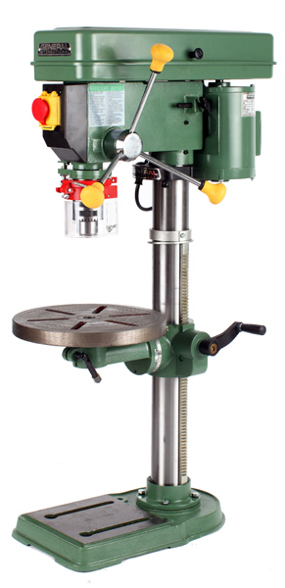
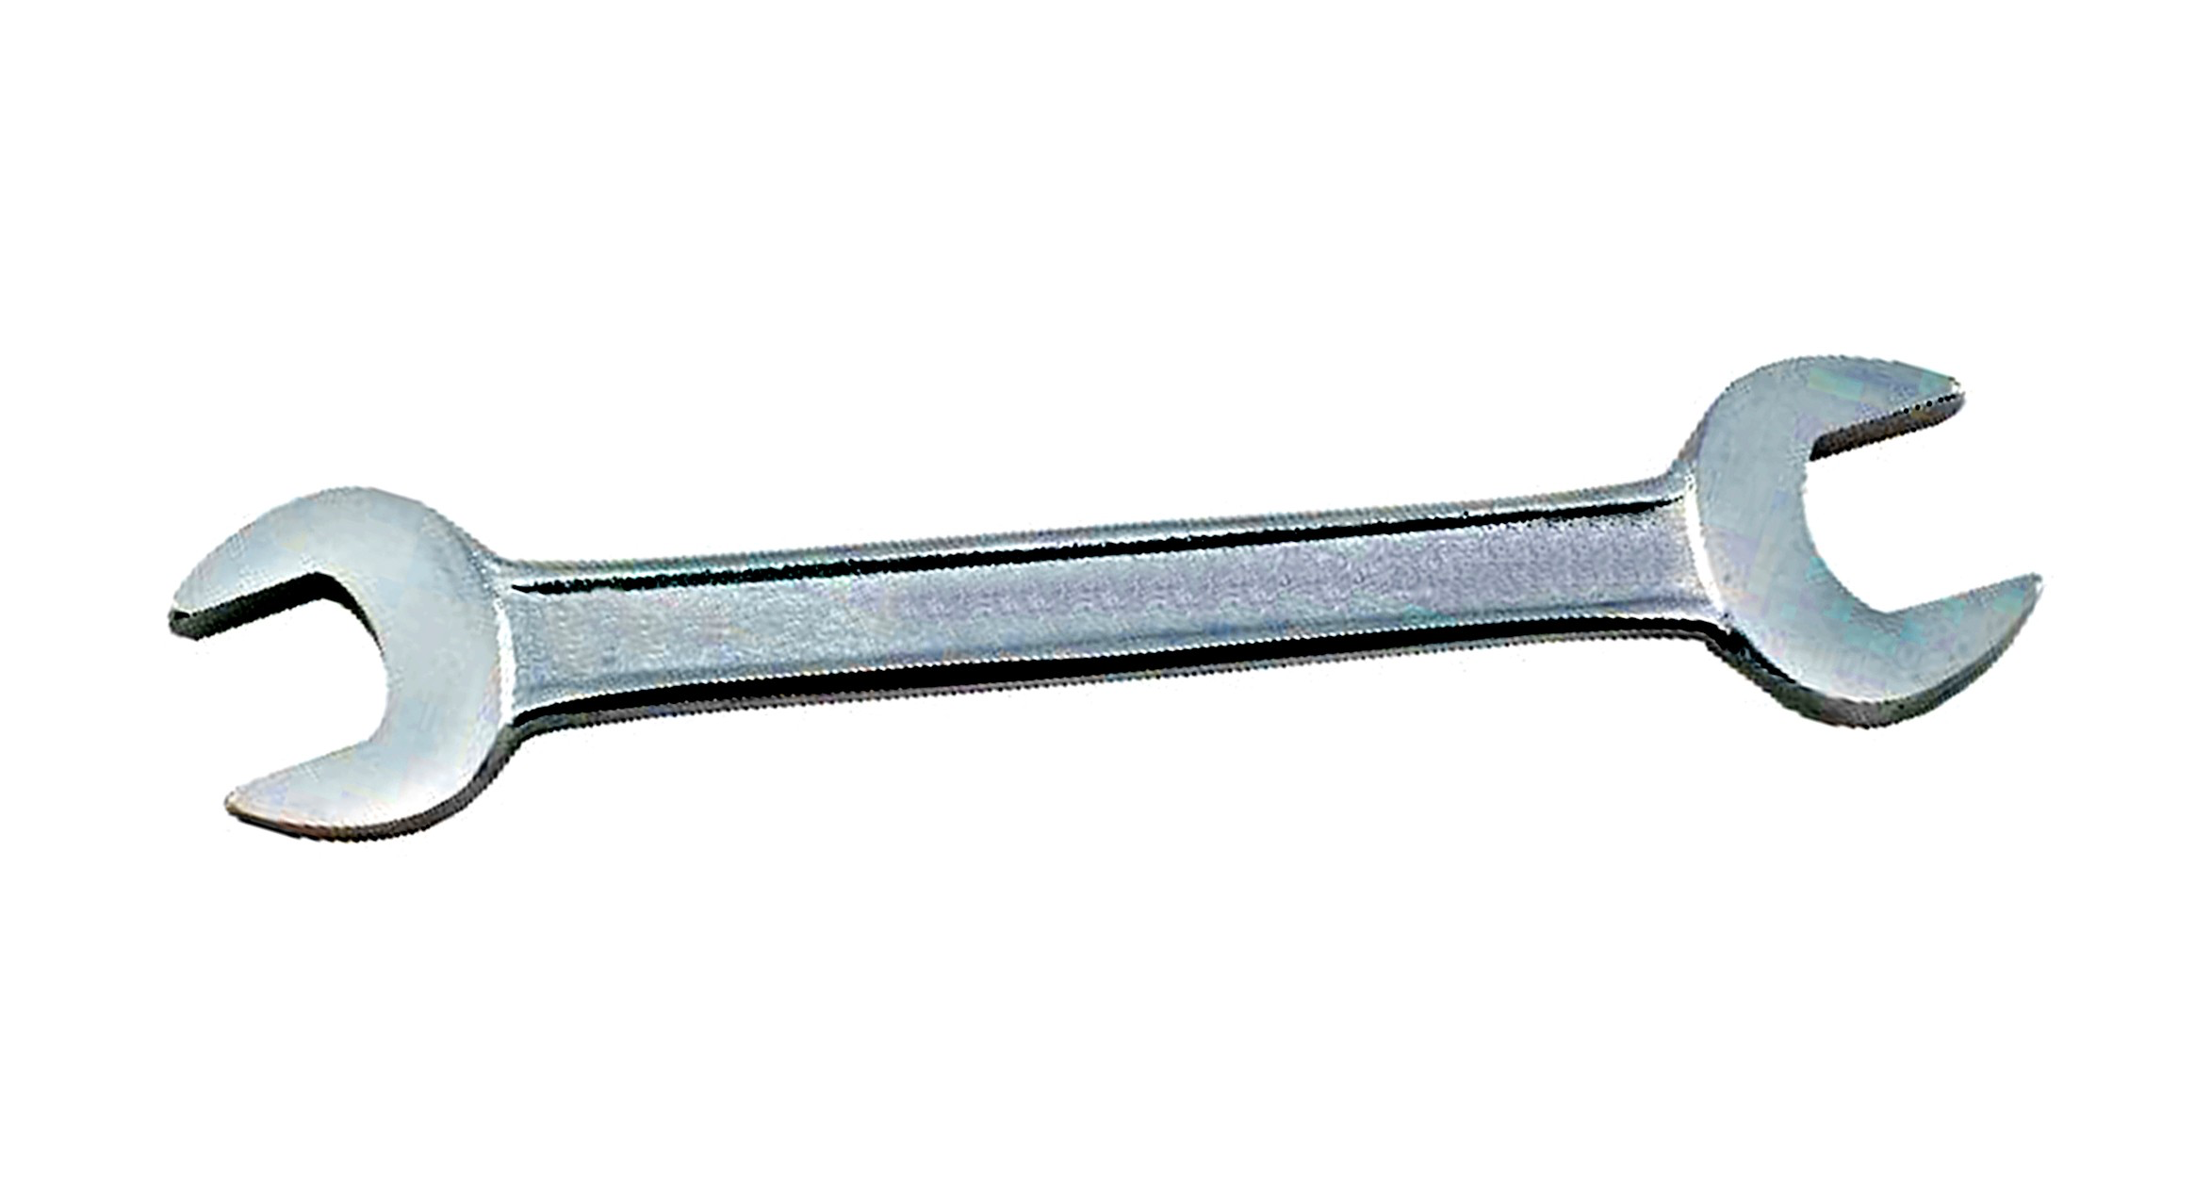
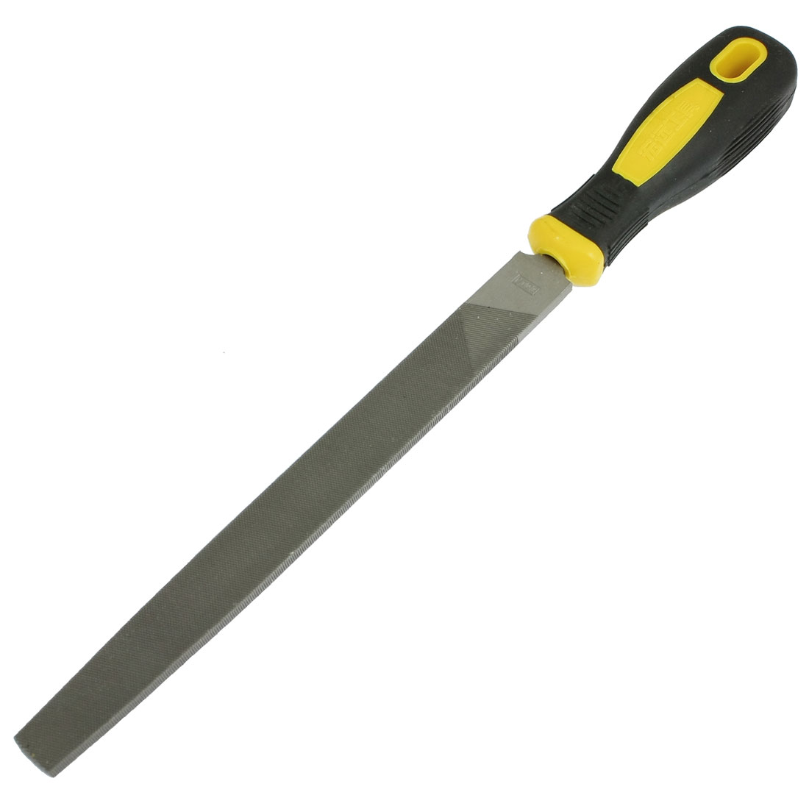
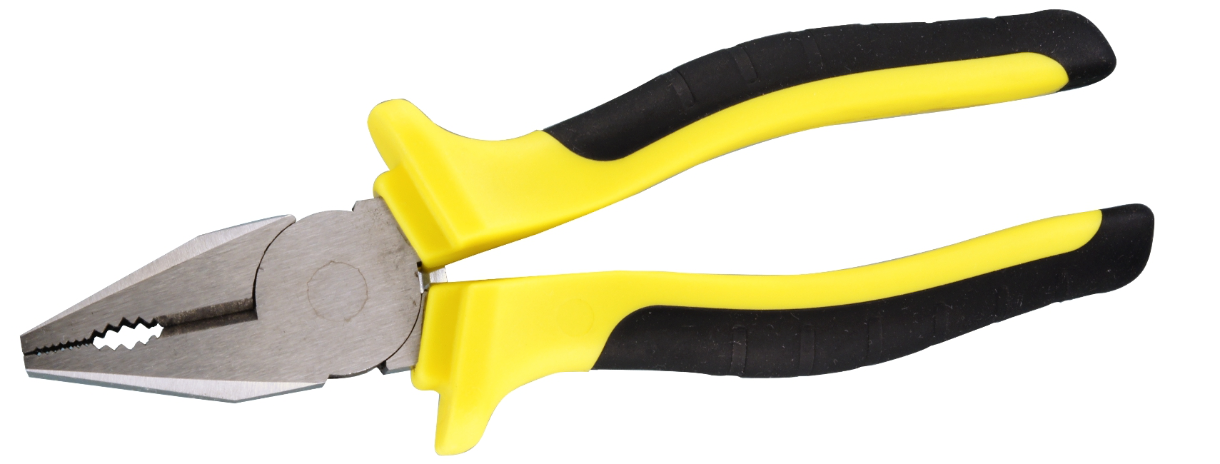
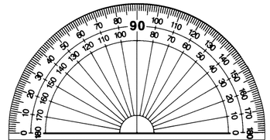
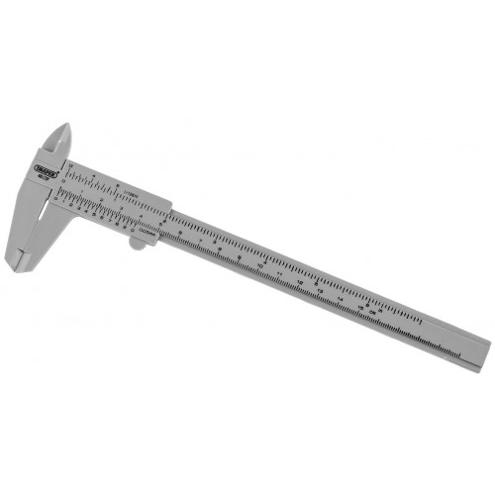
Tools Required
Tools marked with * are optional
Hand saw | Ruler | Bench vice*
Hand drill | Tape measure | Power saw*
Spanners (various sizes) | Thread-lock
File | Pliers | Drill press*
Protractor | Callipers

Slide 6
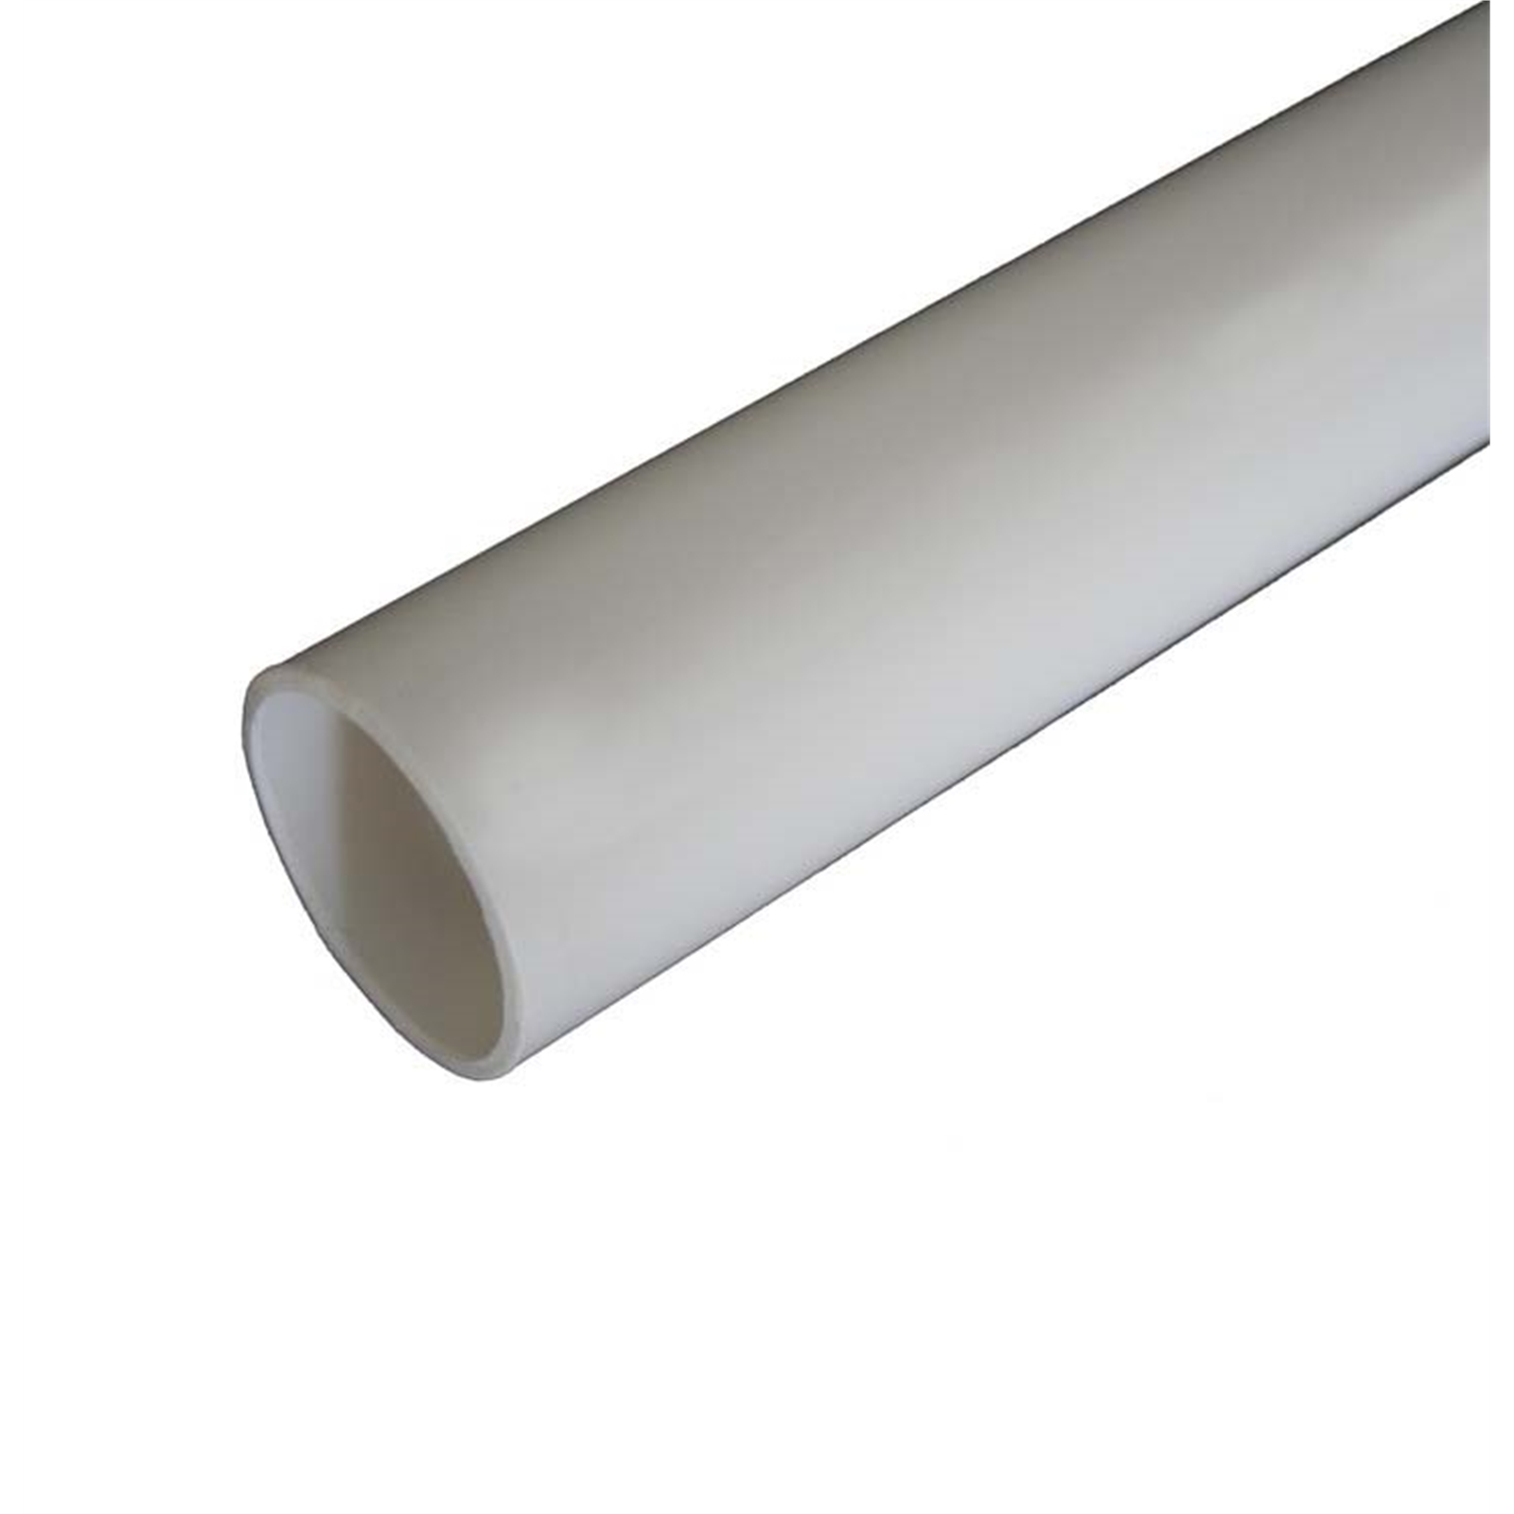
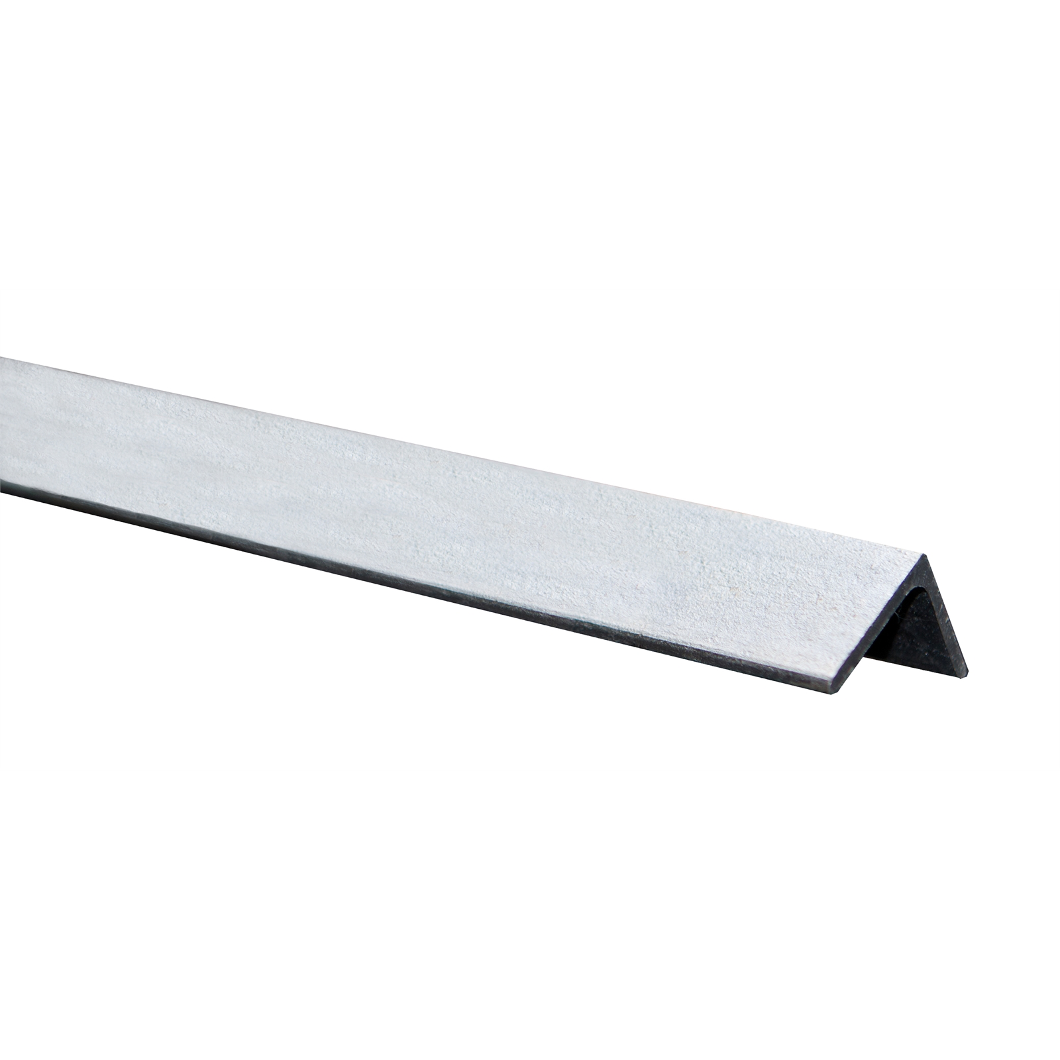
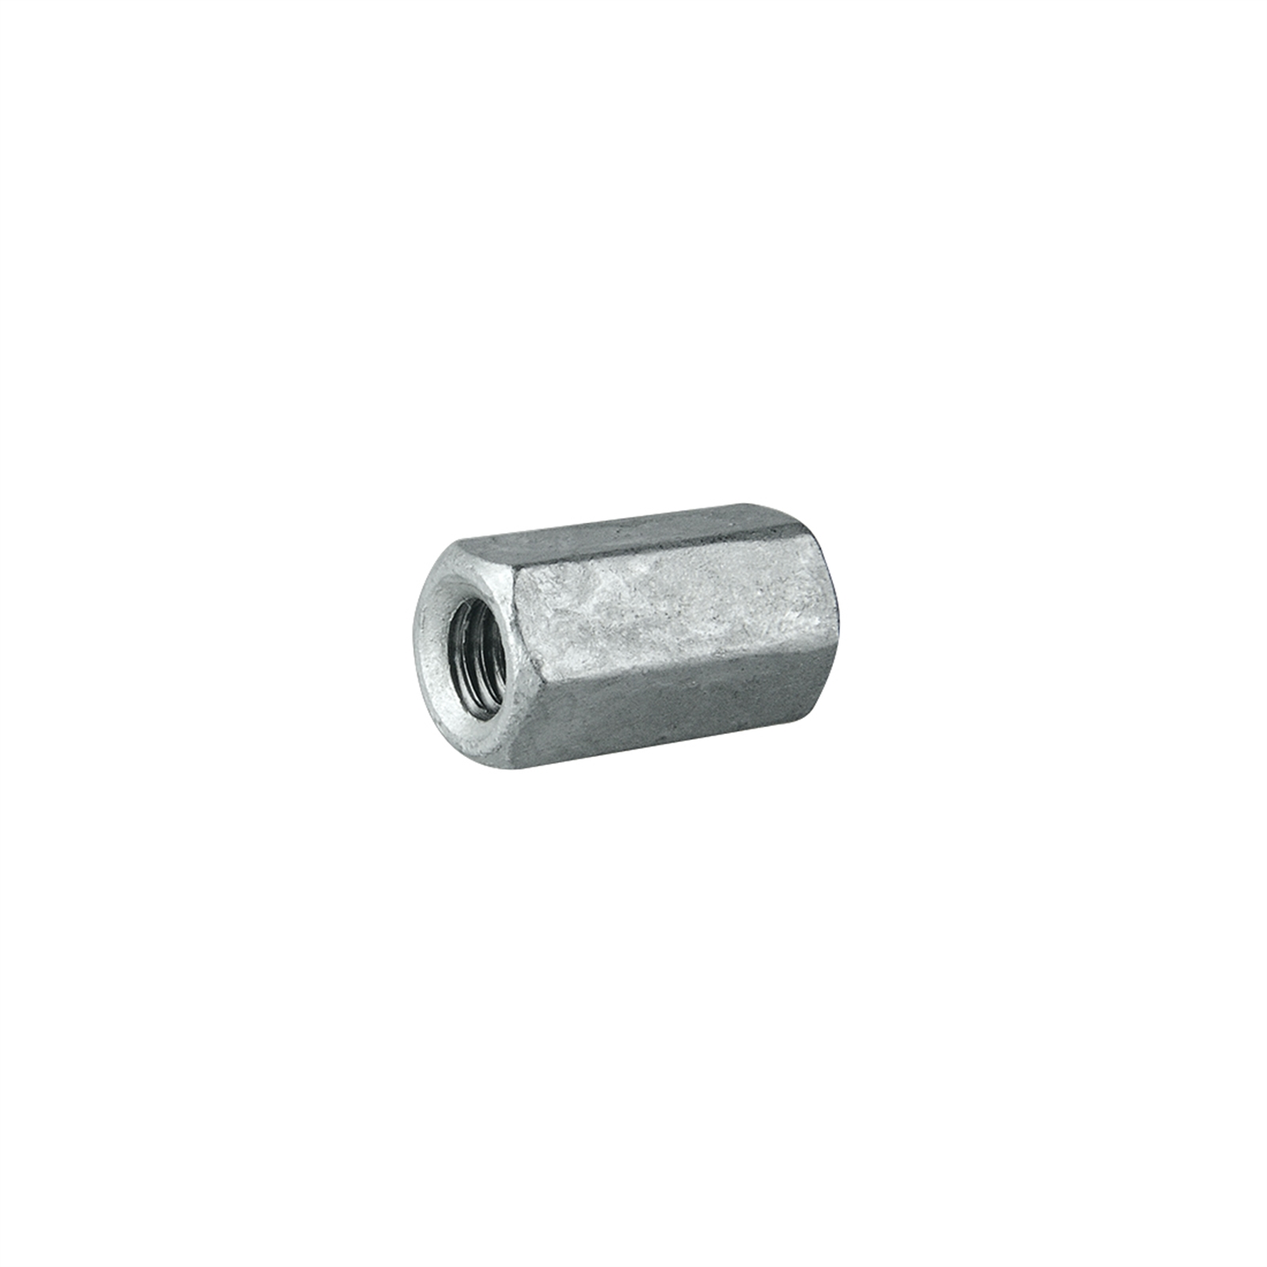
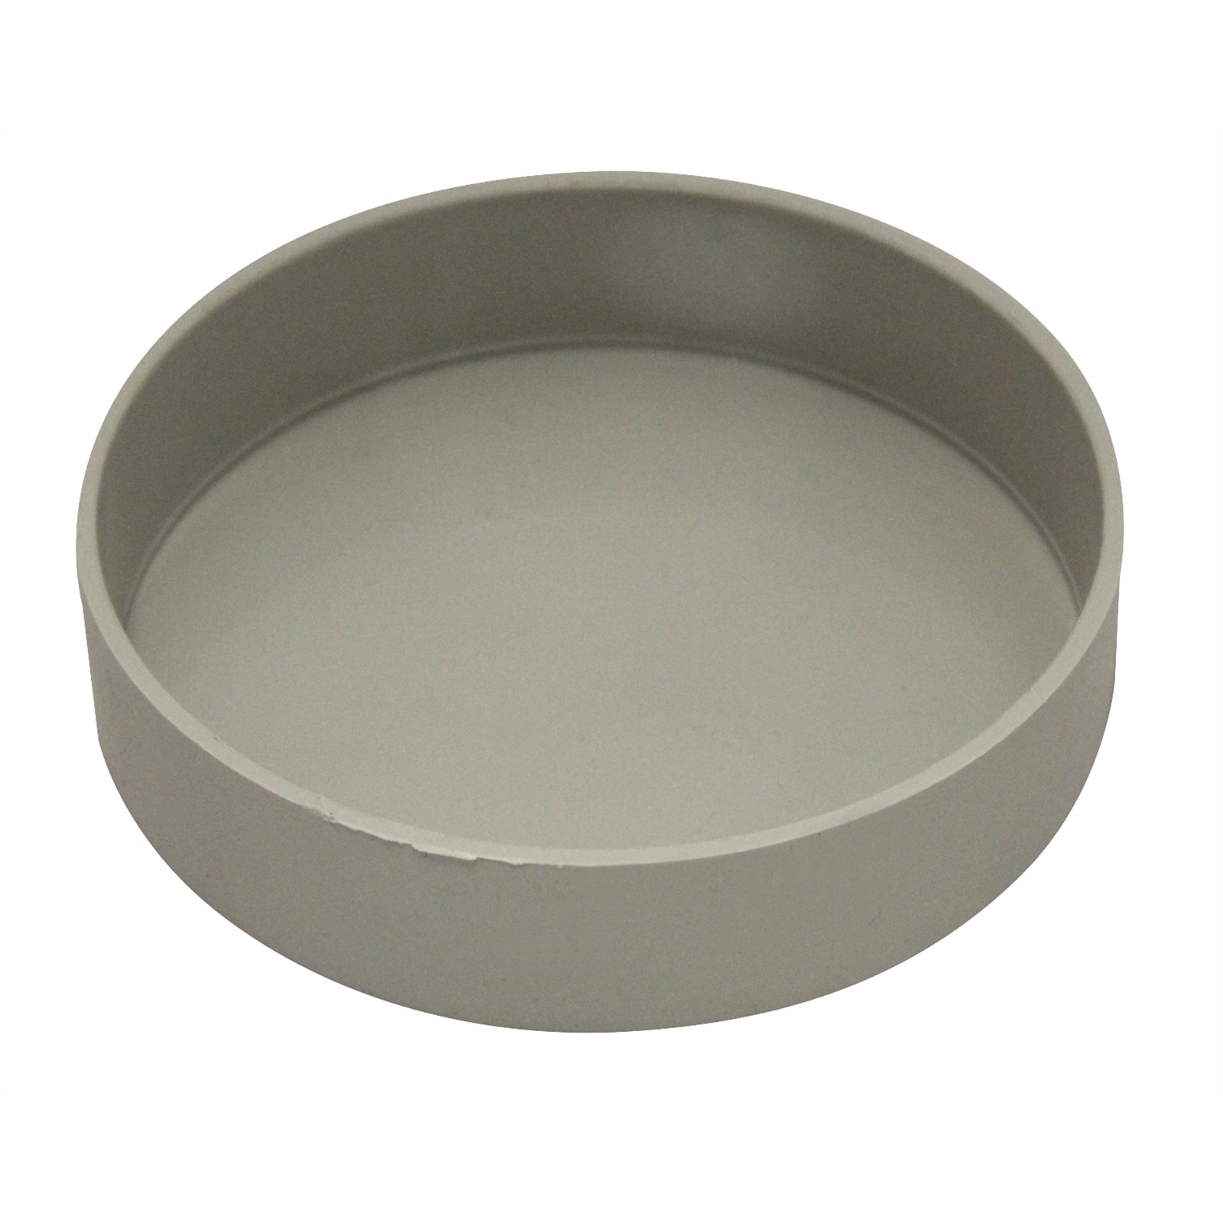
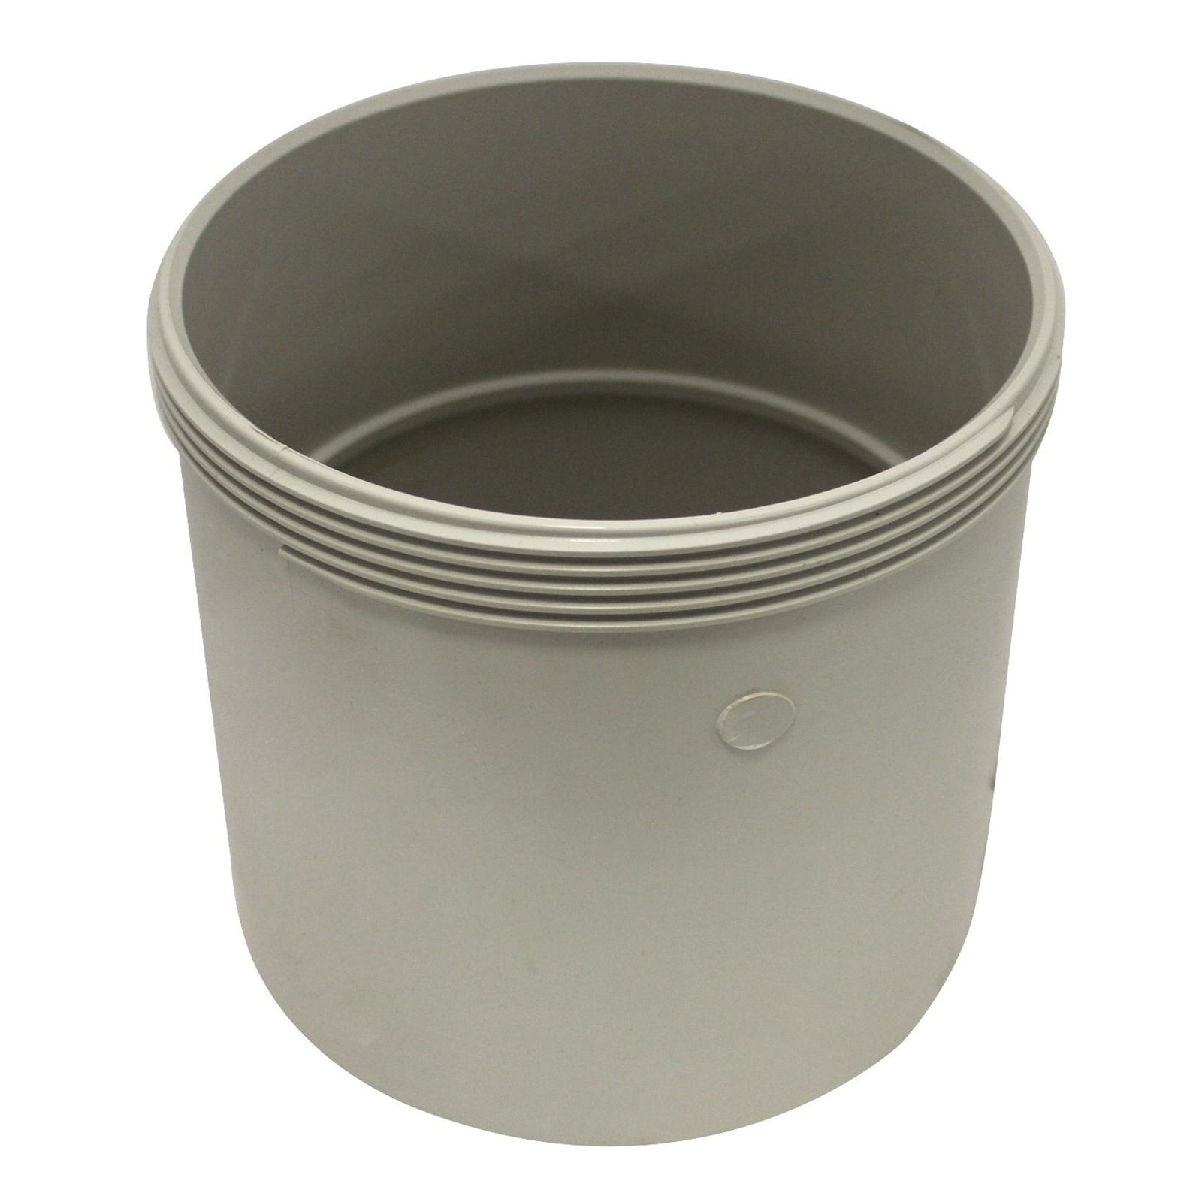
Materials
90mm x 1m PVC pipe | x1
12x12x1.4mm Angle Iron (0.5m long) | x1
M16 x 60mm hex coupler | x1
100mm PVC end cap | x1
150mm PVC threaded access coupling | x1

Slide 7
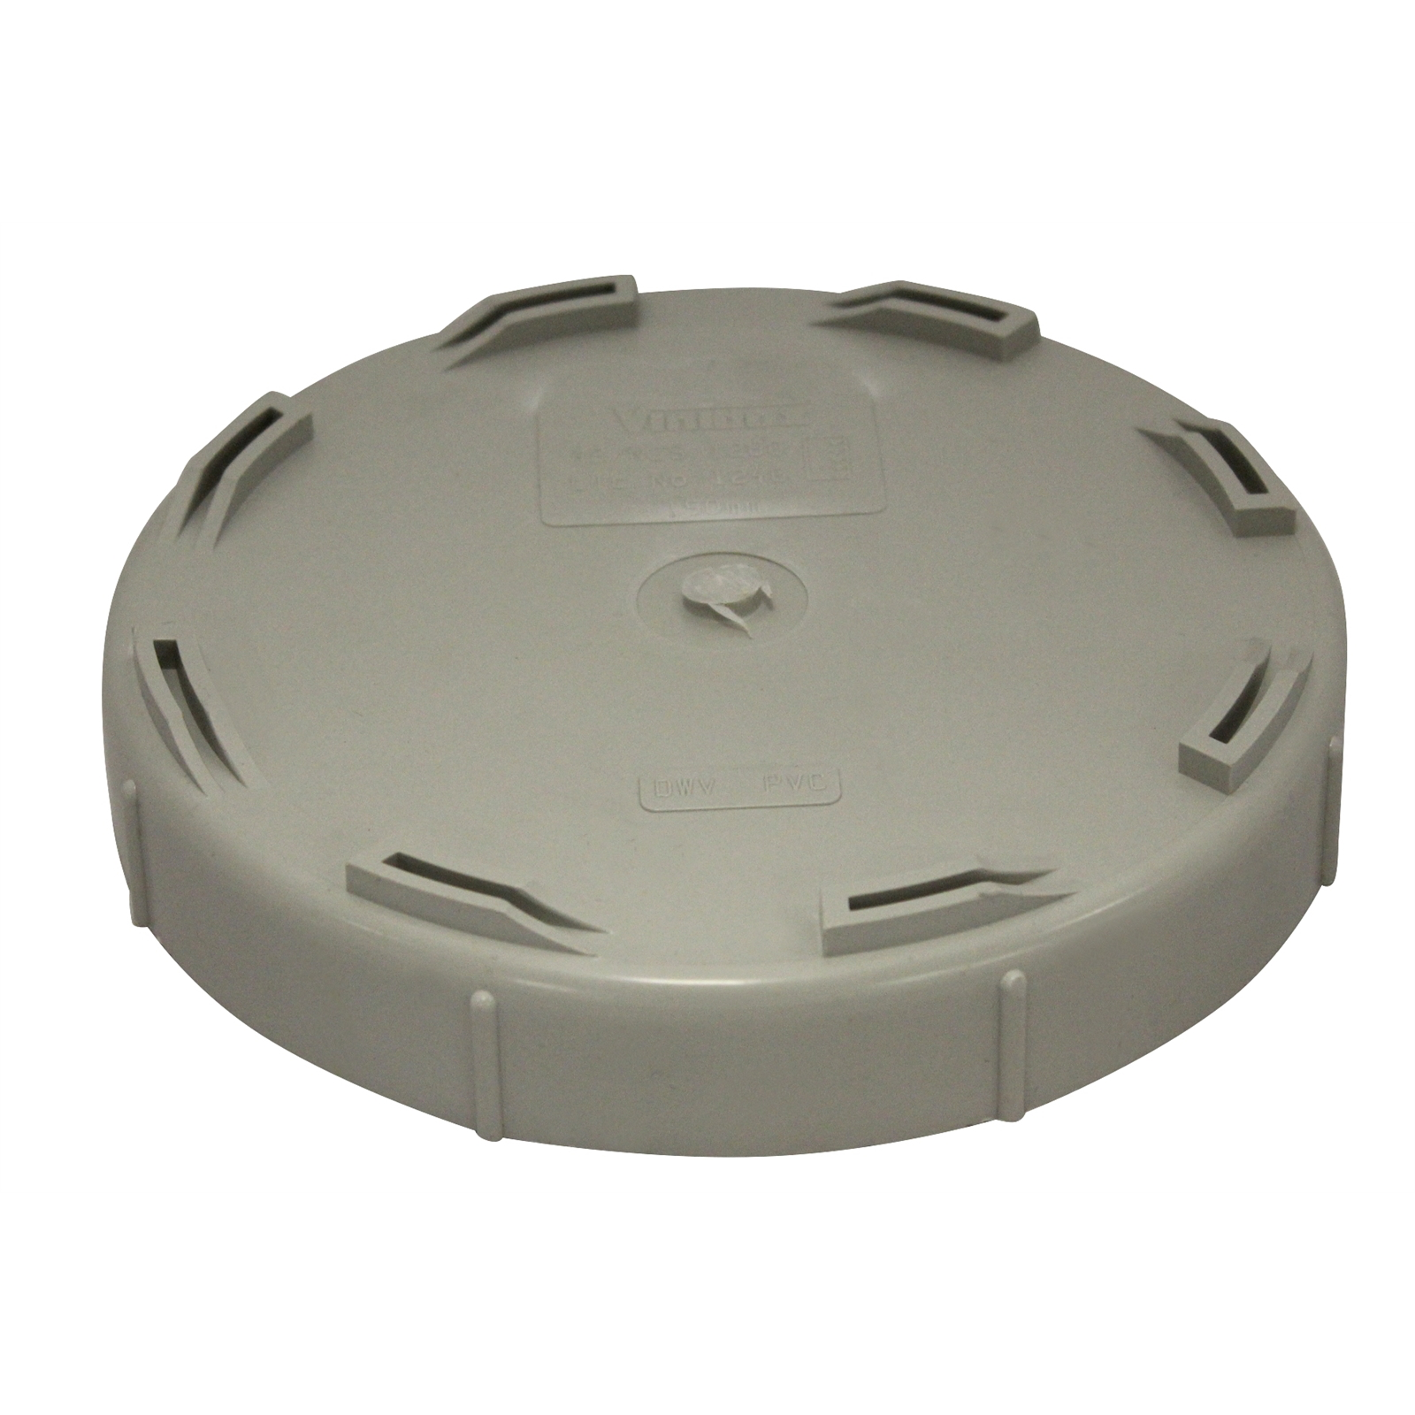
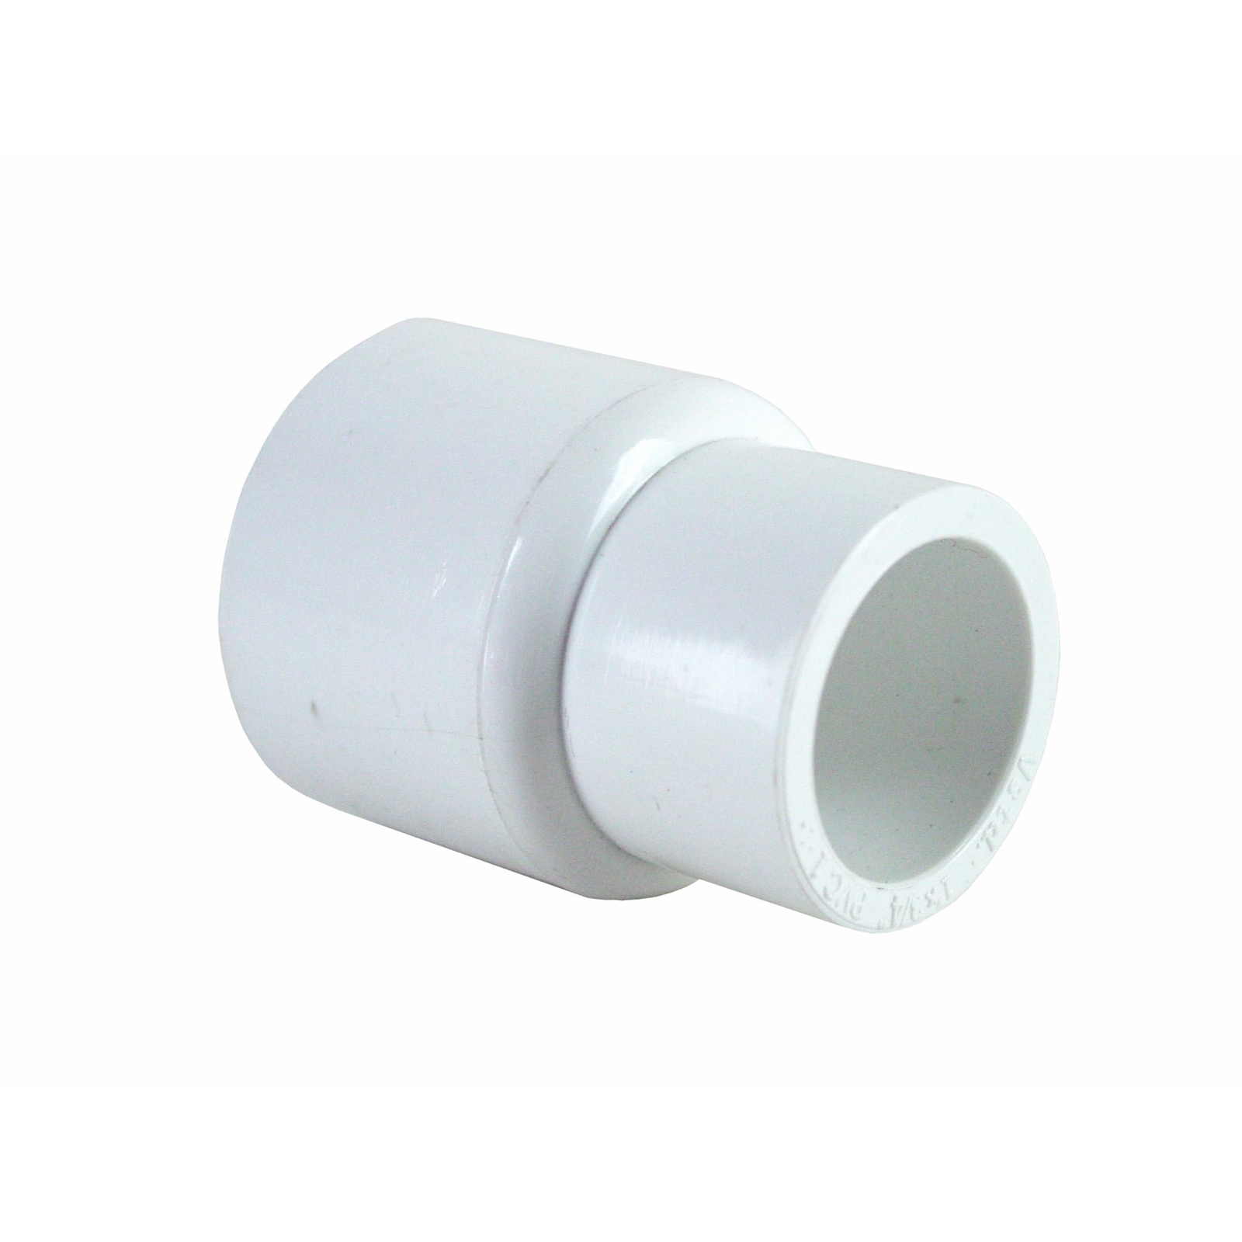
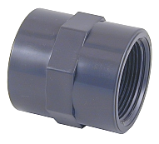
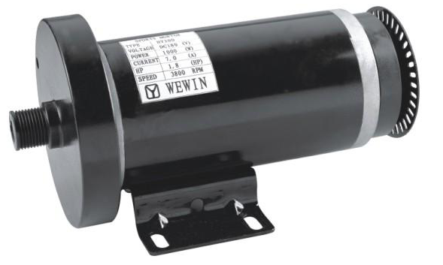
Materials
150mm PVC threaded end cap | x1
150mm PVC end cap | x1
20mm to 15mm PVC reducer | x1
15mm PVC male thread adapter | x1
Treadmill motor | x1

Slide 8
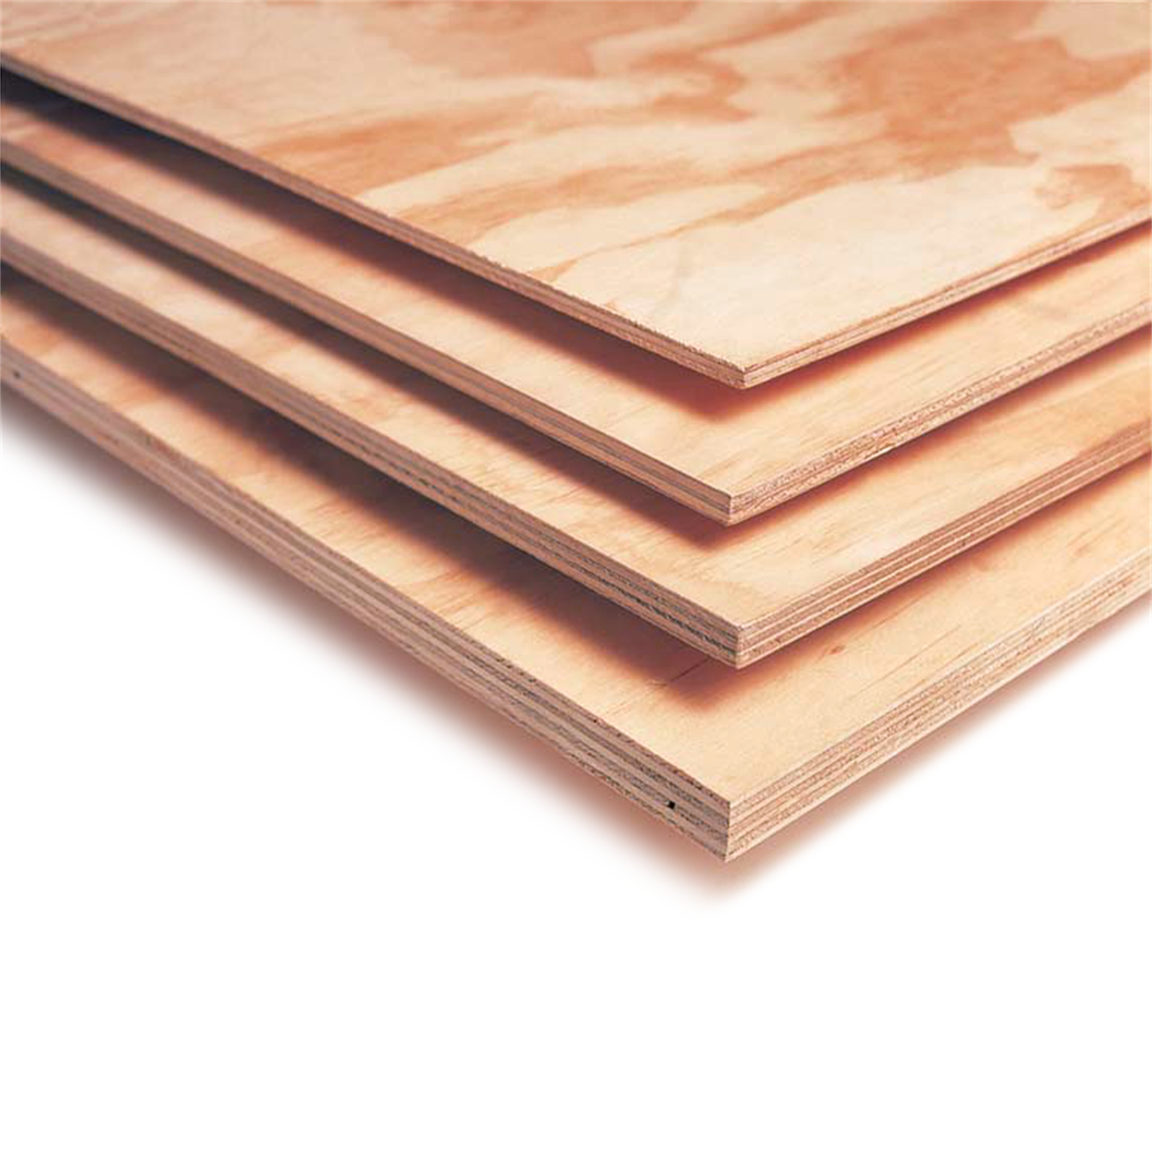
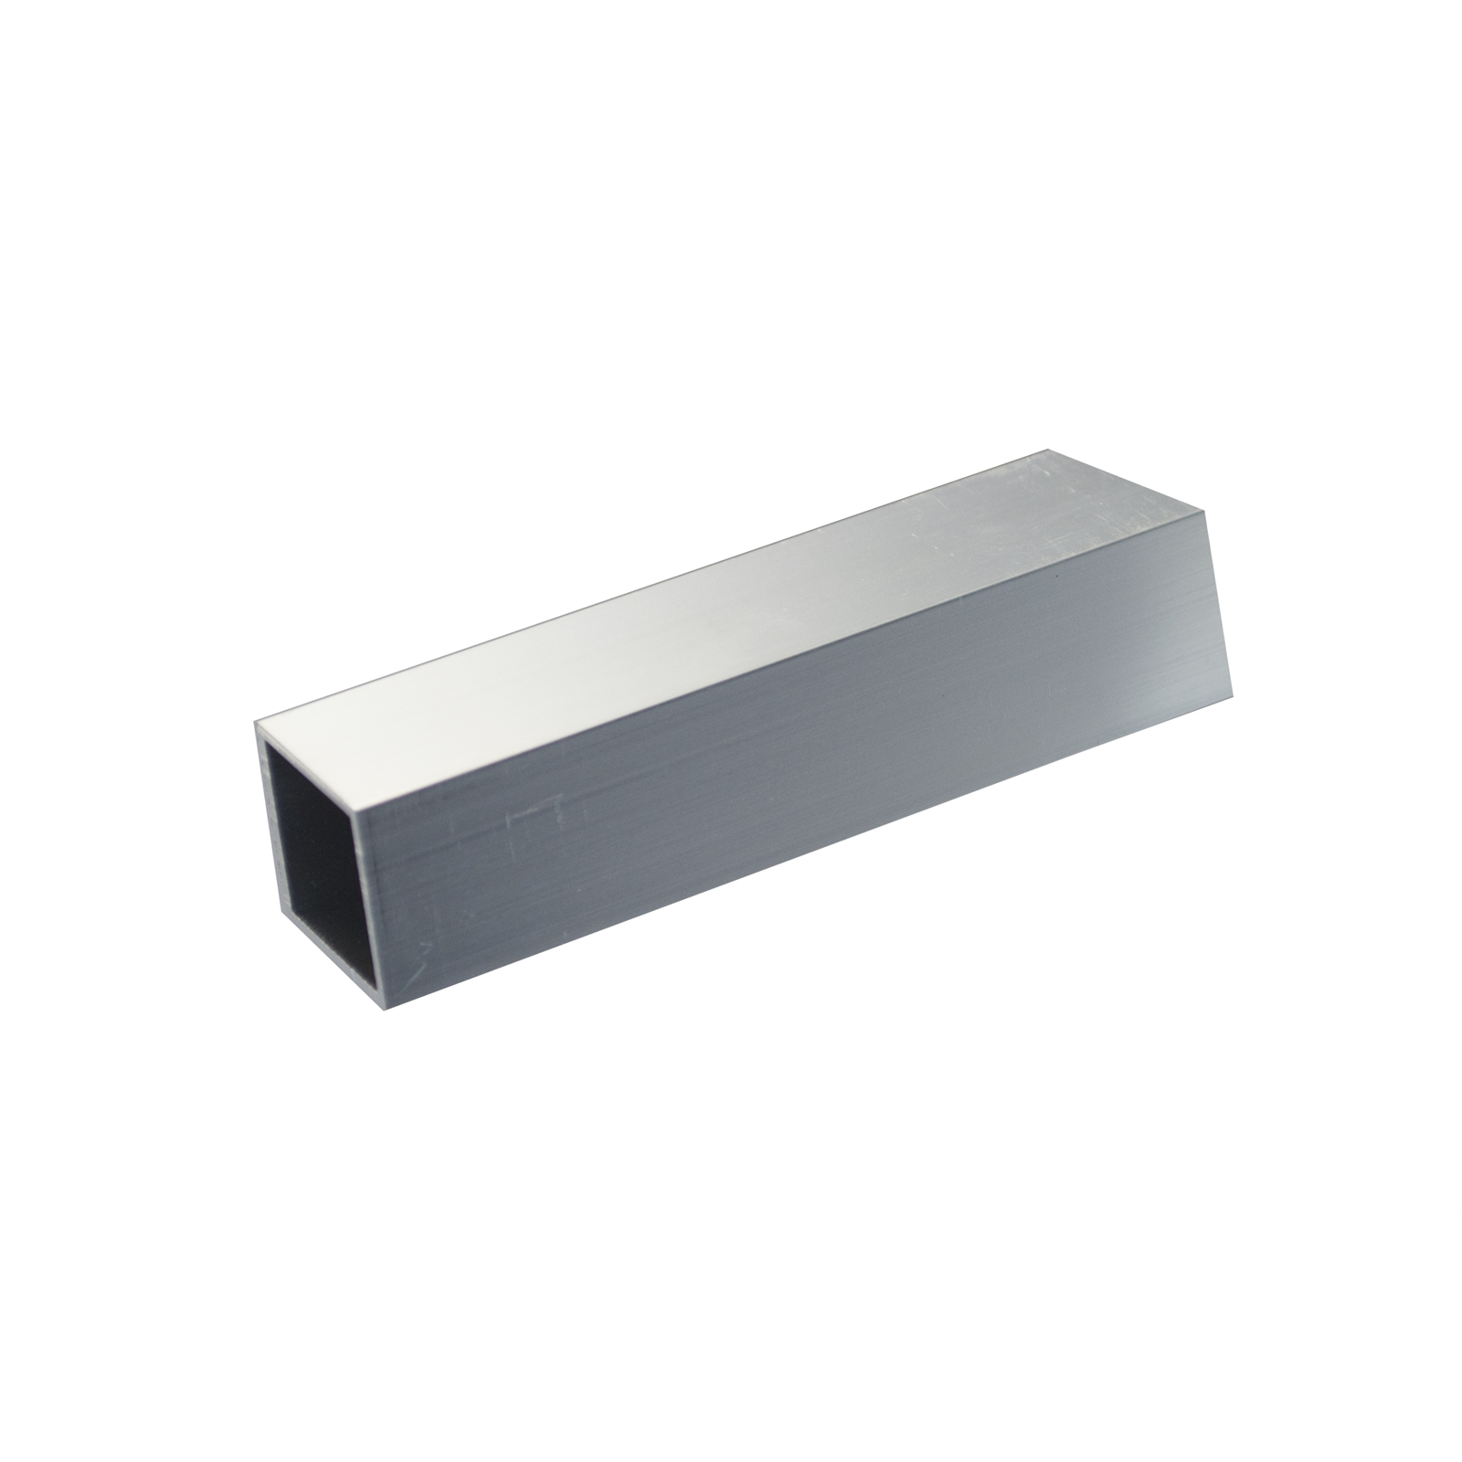
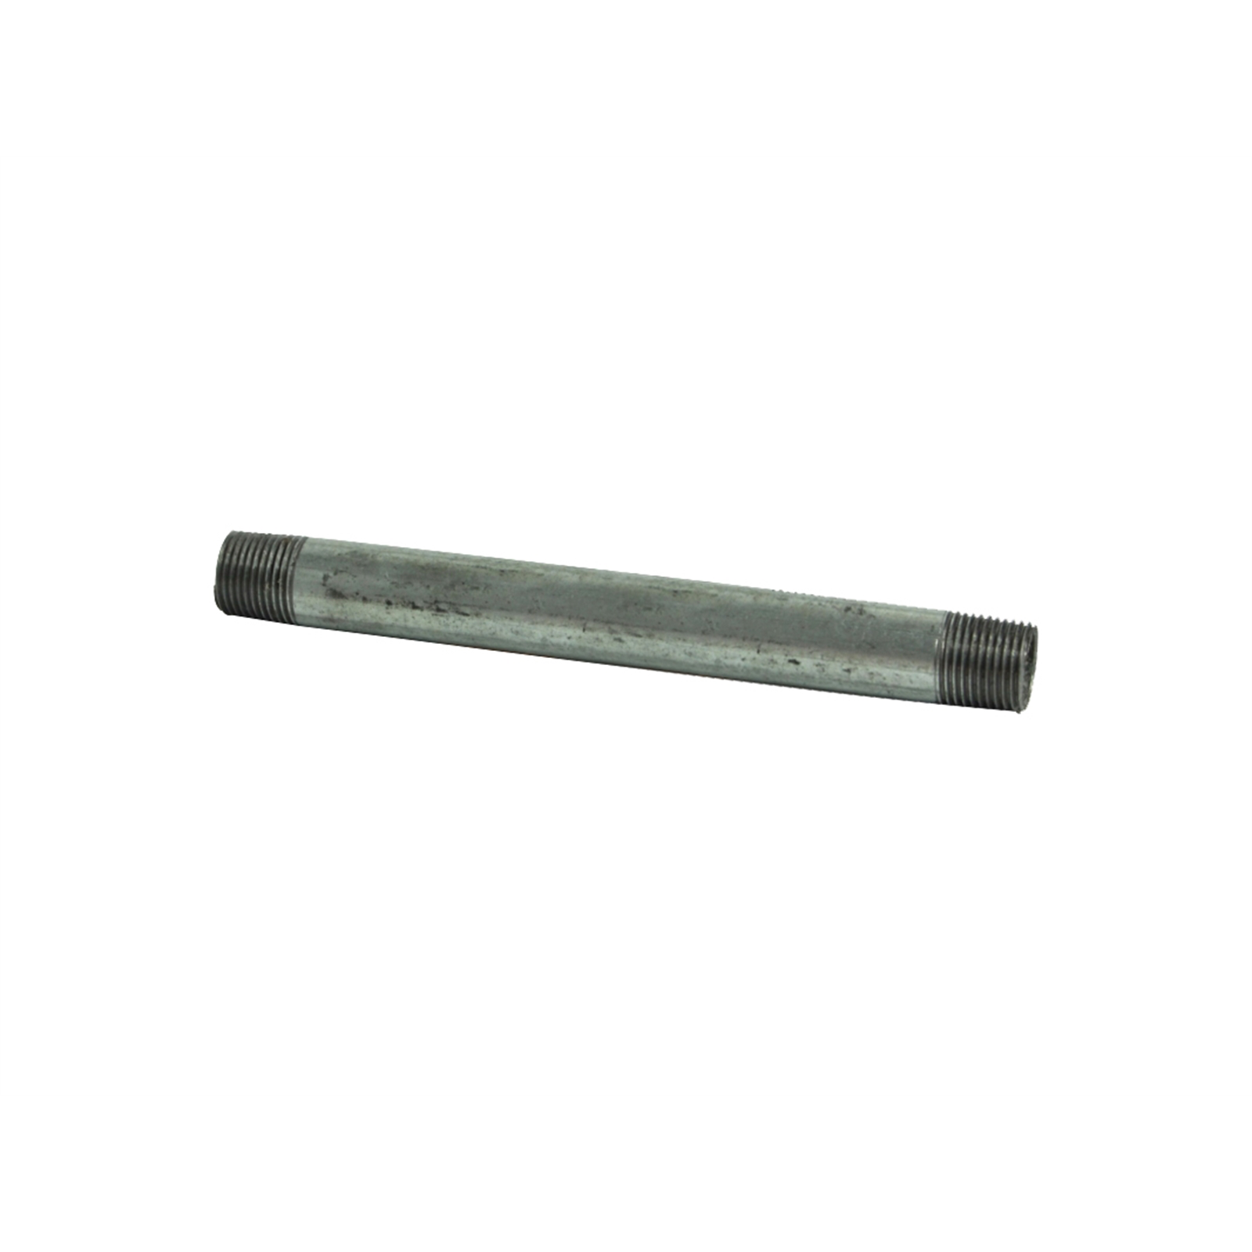
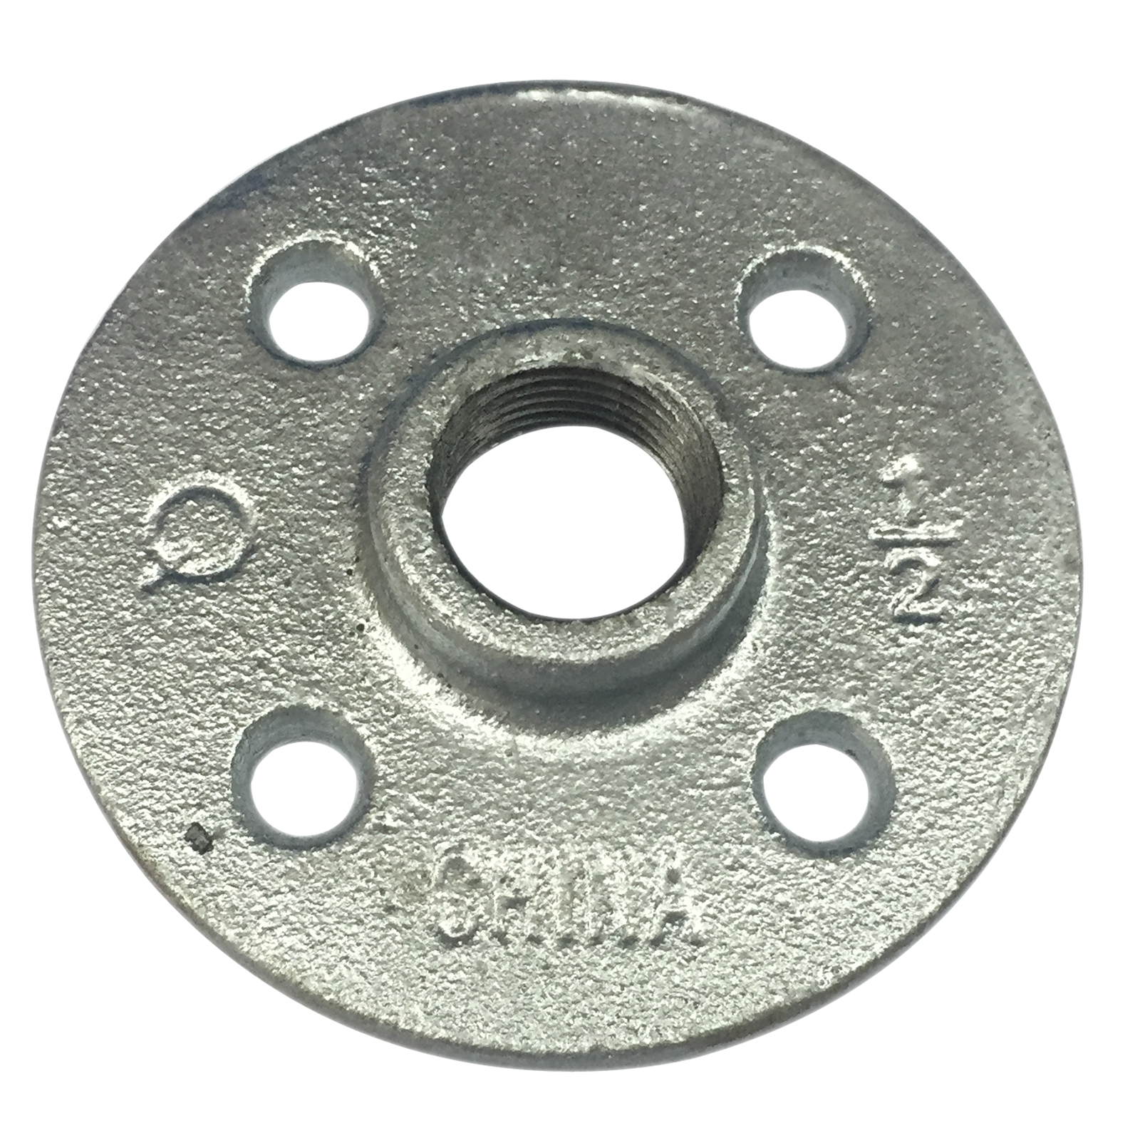
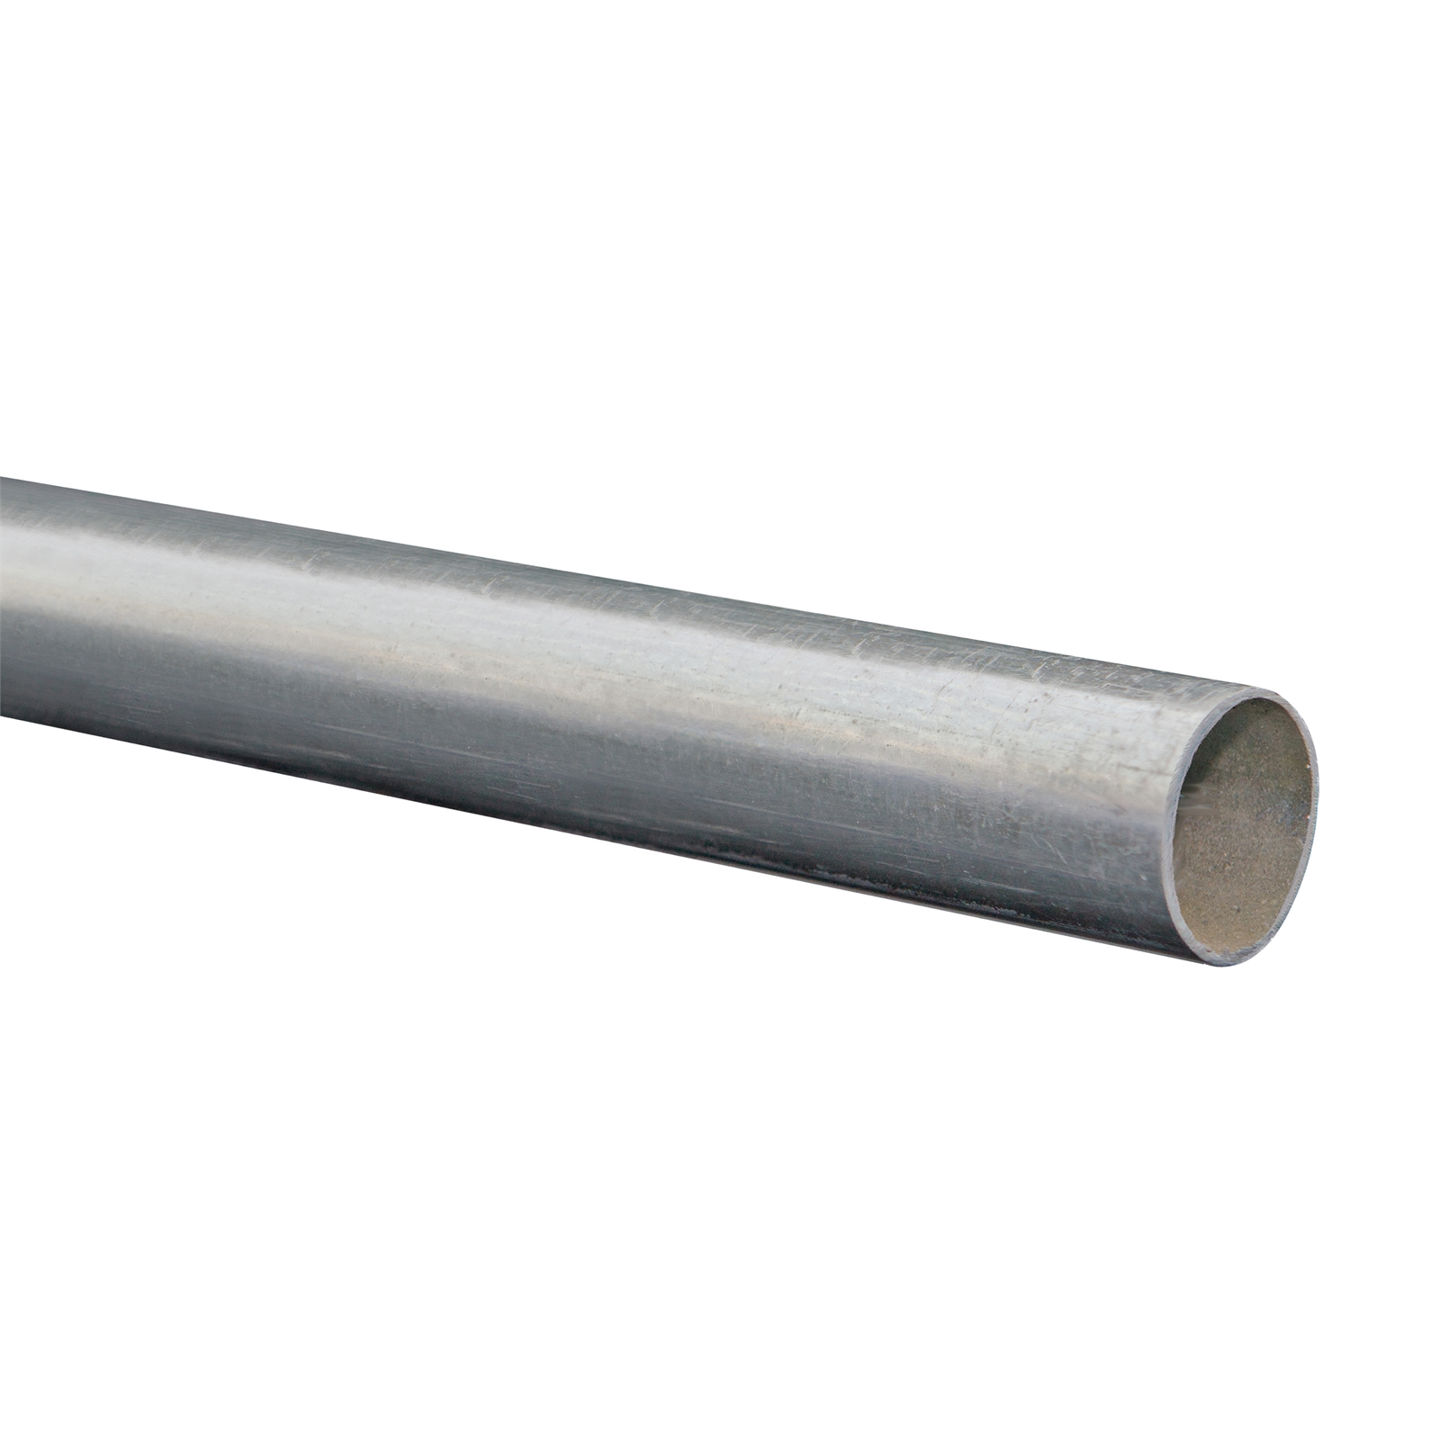
Materials
300x300x5mm plywood | x1
19mm aluminium box section (500mm long) | x1
15mm x 200mm pipe | x1
15mm pipe flange | x1
31.8x1.2mm steel tubing (3m long) | x1

Slide 9
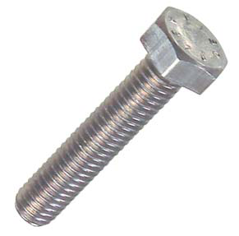
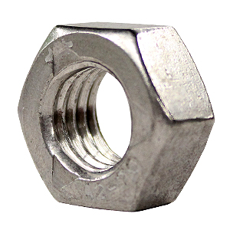
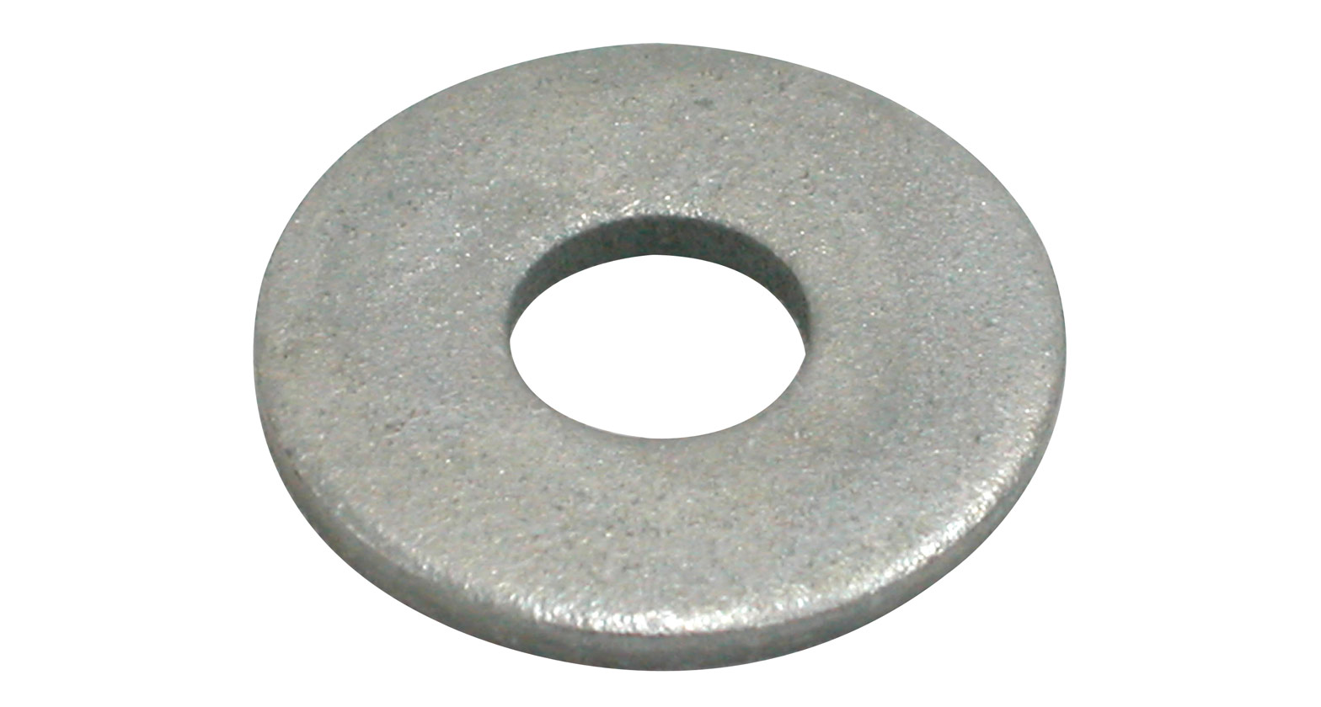
Fasteners
Bolts: M16x100mm M7x20mm M5x25mm M5x35mm 0.5”x1.5” | x1 x4 X10 X4 x4
Nuts: M16 M7 M5 0.5” | x1 x4 X14 x4
Washers: M7 M5 0.5” | x4 X14 x4

